Slide 1
Good Morning !!!!!
Get out your map and your worksheet from last week (if you have not already turned it in). Those will need to be turned in before you leave today. I will give you five mins to finish up your map and then we are moving on.
Today we are identifying the way that the British King plans on paying for the French and Indian war.
Hint: people are not going to like it.

Slide 2
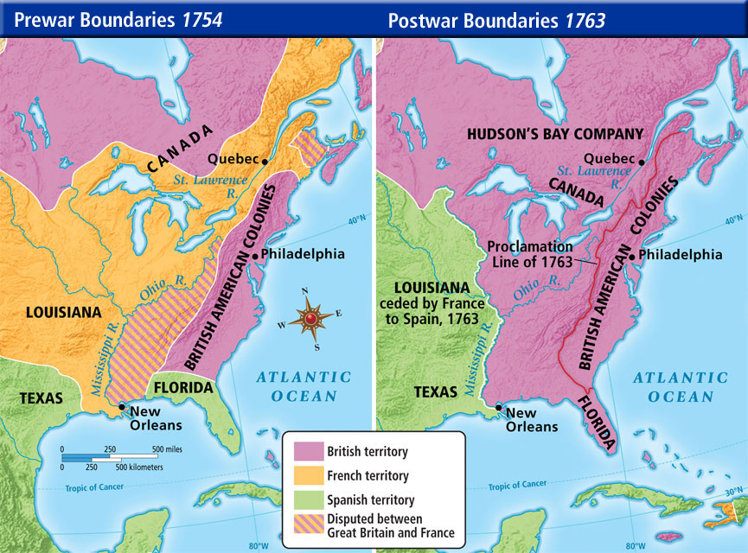
Boston
Boston

Slide 3
DEBT!!!!
The French and Indian war was expensive
The King of England imposed higher taxes to raise money to pay off war debts
The colonists still did not have any representation in England.

Slide 4
Colonial Perspective after French and Indian War:
Colonists enjoyed economic independence from Great Britain because of Salutary Neglect
Colonists wanted limited Government interference from Great Britain and a free trade system.
Distance from Great Britain (3000 miles away) made colonial representation in Parliament impossible.
Many colonists believed lack of representation violated their rights

Slide 5
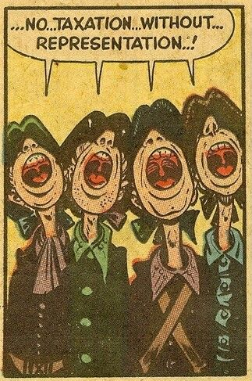
Colonists didn’t want to be taxed unless they could have representatives in British Parliament to act on their behalf. Without this, they believed they had no political voice.

Slide 6
British want to tax the Colonies…..

Slide 7
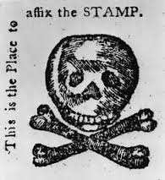
Stamp Act (1765): Tax on things
Required legal documents and paper products to have an official stamp showing that a tax had been paid.
Legal documents, licenses, news paper and even playing cards were required to have a stamp

Slide 8
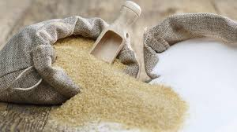
Sugar Act - Food
Tariff on good that were not bought from Britain.
Sugar, coffee and wine.
It made British goods cheaper so the colonist were forced to by from them.

Slide 9
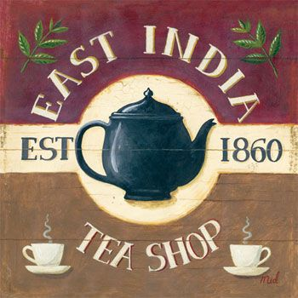
Tea Act/Townshend
This law gave the East India Company (British) the sole right to sell tea in the colonies
No other company could sell tea there, even if the colonist wanted a different type of tea.

Slide 10
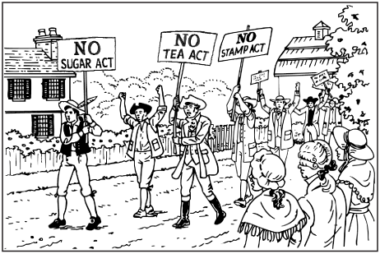
British Taxation

Slide 11
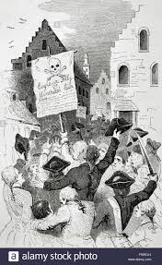
Colonist Reaction
Protest – public demonstrations, loud
Boycotts – refusal to buy goods from Britain
Smuggling in goods, making normal people criminals
The Parliament (the British Legislature) did repeal the
Stamp act but not soon enough.

